Slide 1
CHAPTER 10 Ensemble Learning Methods

Slide 2
Each class of algorithms has merits and demerits and suits a particular class of problems.
Ensemble learning, as shown in Figure 10-1, is a suite of techniques that uses multiple machine learning models in order to obtain better performance than we could have from any of the models.
In many use cases, the individual models are called weak learners.
In this chapter, we will learn techniques to combine the learning capabilities of small low-performance weak learners to create a high-performance and more accurate model.

Slide 3
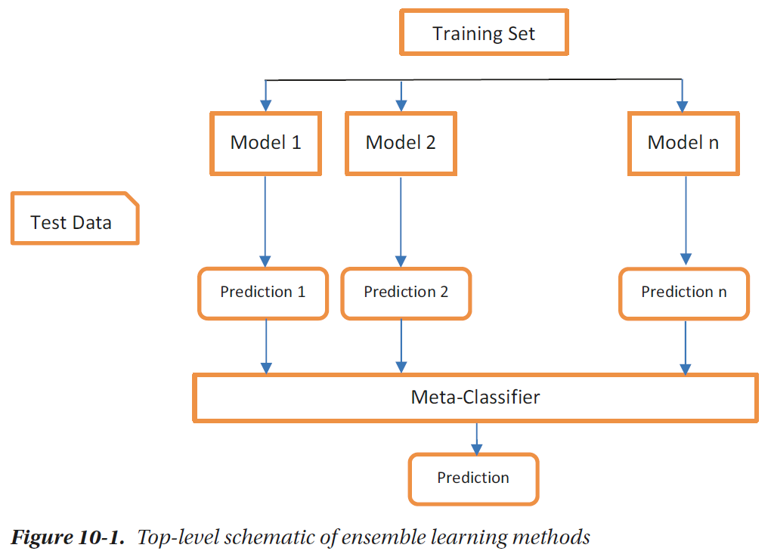

Slide 4
Bagging and Random Forest
As we saw in the previous chapter, decision trees are constructed by selecting one of the attributes that provides the best separation of the classes.
This is done either by computing the information gain or Gini index. Based on the splitting criteria, the dataset will follow one of the child nodes shown in Figure 10-2.

Slide 5
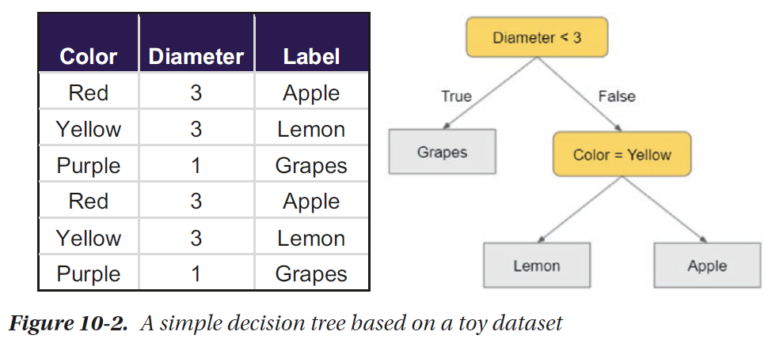

Slide 6
If we select a slightly smaller subset of the dataset, the tree thus constructed, even with the same splitting criteria and pruning rules, might be much different than the one compared earlier.
Figure 10-3 shows a new decision tree that was created by randomly selecting four (out of six) data points.
The structure of the tree may totally change by changing the dataset as the computations of splitting criteria will change to reflect the statistics of the new training dataset.
This is the idea behind one of the simple yet highly effective ensemble methods called random forest.

Slide 7
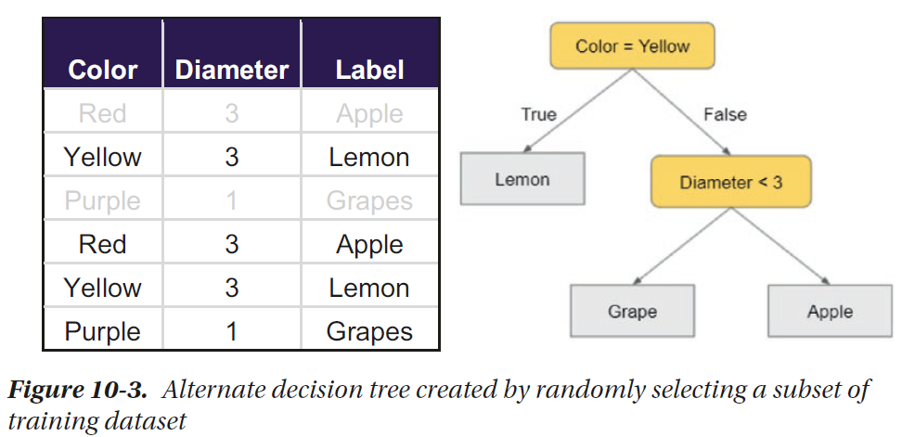

Slide 8
Bagging, or Bootstrap Aggregating, creates an ensemble model through bootstrapping and aggregation processes.
Instead of creating a model on the whole training dataset, we pull a sample of the training set and use it for training instead.
The sample is generated randomly with each training data point having the equal probability of being sampled.
If N represents the size of training dataset and M is the number of random data points to be considered for training, and M<N, each point is randomly sampled with replacement; that is, it can occur more than once in the subset.
This also means there is a probability that a data point might not occur in the training dataset at all.

Slide 9
In the training process shown in Figure 10-4, we create k models, where k is a predefined number and a hyperparameter that is easy to configure.
Each tree is constructed independently, and thus, the process can be implemented in parallel.
Eventually, we will have k-independent decision trees with possibly different structures, and they might give different results for the same test item.

Slide 10
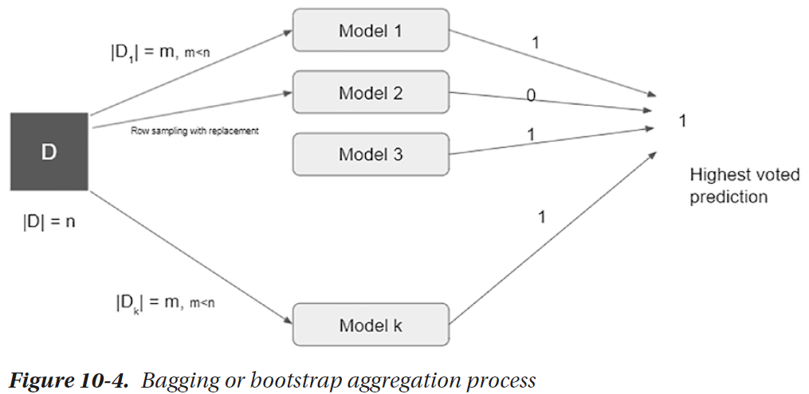

Slide 11
During the prediction phase, the test item runs through each tree and is assigned a label by the decision tree.
The labels are then aggregated and voted – and the label with the highest number of votes across the k trees is considered as the final output.
In this example, if k=4 and the class labels predicted by the four models are 1, 0, 1, and 1, there are three votes for 1 and one vote for 0. Thus, the final class that is assigned is 1.

Slide 12
Random Forest in Python
In this short example, we aim to construct a random forest for classification of Iris dataset and visualize the individual trees that are a part of the ensemble.

Slide 13
In Scikit-learn, sklearn.ensemble package contains implementations of various ensemble methods for classification, regression, and anomaly detection.
One of the options is the Bagging meta-estimator, which accepts another weak classifier as an argument and builds several instances of the weak classifier on random samples of the training set.
This treats the internal weak-classifier algorithm as a black box and doesn’t require any changes in how the internal models work.

Slide 14
To create a random forest, we will use RandomForestClassifier, which allows decision tree–specific hyperparameters that can be easily tuned externally.
It learns a large number of decision tree classifiers on various random samples of the dataset in order to improve the quality of predictions.

Slide 15
We can specify Bagging specific hyperparameters, like max_samples, which is used to specify the number or ratio of training data points that will be randomly selected in each iteration.
Besides, we can specify n_estimators, which is the number of individual trees that are created.
Apart from these, other hyperparameters like max_depth, min_samples_split, criteria, etc., can be used the way they are used while constructing a decision tree.

Slide 16
Let’s initialize a random forest with ten trees and train it.
  import pandas as pd
  from sklearn.datasets import load_iris
  iris = load_iris()
  df = pd.DataFrame(iris.data, columns=iris.feature_names)
  from sklearn.model_selection import train_test_split
  X_train, X_test, y_train, y_test = train_test_split(df, iris.target,test_size=0.3)
  from sklearn.ensemble import RandomForestClassifier
  clf = RandomForestClassifier(n_estimators=10, max_samples=0.7)
  clf.fit(X_train, y_train)

Slide 17
The constituent decision trees can be visualized through clf.estimators_. We can iterate over them and visualize the structure of the trees using Graphviz and PyDotPlus.
  from IPython.display import Image
  from sklearn.tree import export_graphviz
  import pydotplus
  for i, estimator in enumerate(clf.estimators_):
  dot_data = export_graphviz(estimator)
  graph = pydotplus.graph_from_dot_data(dot_data)
  graph.write_png('tree'+str(i)+'.png')
  display(Image(graph.create_png()))

Slide 18
Boosting
Boosting is another highly popular ensemble learning technique. Instead of constructing independent trees through random samples of the training data, boosting process constructs the trees in an iterative process.

Slide 19
In boosting, the ensemble is created incrementally by training a new model from a subset of the training data that considers a more proportion of data points that the previous models misclassified.
In this section, we will discuss a boosting method called AdaBoost that incrementally builds decision trees using this method.

Slide 20
AdaBoost further simplifies the decision trees by constructing decision stumps, which is a weak learner by itself, but the boosting process ultimately combines such weak learners to create a more accurate classifier.
A decision stump, as shown in Figure 10-6, is a simple decision tree consisting of only one split, thus a height of one.
This means each classifier splits the examples into two subsets using only one feature.

Slide 21
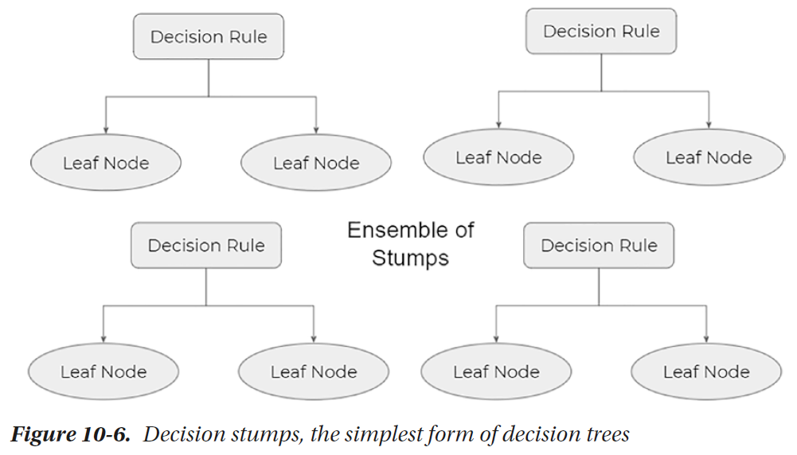

Slide 22
Each stump is a very simple classifier with a linear and straight decision boundary. Thus, a stump can’t do much by itself.
However, as shown in Figure 10-7, the process of sampling and assigning weights to each stump individually is what improves the end results.

Slide 23
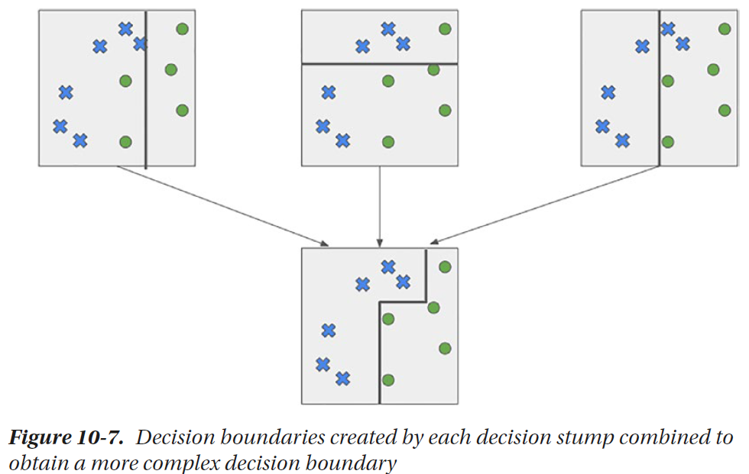

Slide 24
Suppose we want to boost the accuracy of a learning method. We are given D, a dataset of d class-labelled tuples, (X1, y1), (X2, y2), .. . . , (Xd, yd), where yi is the class label of tuple Xi.
Initially, AdaBoost assigns each training tuple an equal weight of 1/d. Generating k classifiers for the ensemble requires k rounds through the rest of the algorithm.
In round i, the tuples from D are sampled to form a training set, Di, of size d. Sampling with replacement is used – the same tuple may be selected more than once. Each tuple’s chance of being selected is based on its weight.
A classifier model, Mi, is derived from the training tuples of Di. In Figure 10-8, Model 1 is generated from the first set of samples where each sample from the training dataset carried equal weight.

Slide 25
A classifier model, Mi, is derived from the training tuples of Di. In Figure 10-8, Model 1 is generated from the first set of samples where each sample from the training dataset carried equal weight.
Now that we have a simple classification model ready, we test the model using the same dataset Di we used for training. The weights of the training tuples are then adjusted according to how they were classified.
If a tuple was incorrectly classified, its weight is increased. If a tuple was correctly classified, its weight is decreased. A tuple’s weight reflects how difficult it is to classify – the higher the weight, the more often it has been misclassified.
These weights will be used to generate the training samples for the classifier of the next round. An overview of this process is shown in Figure 10-8.

Slide 26
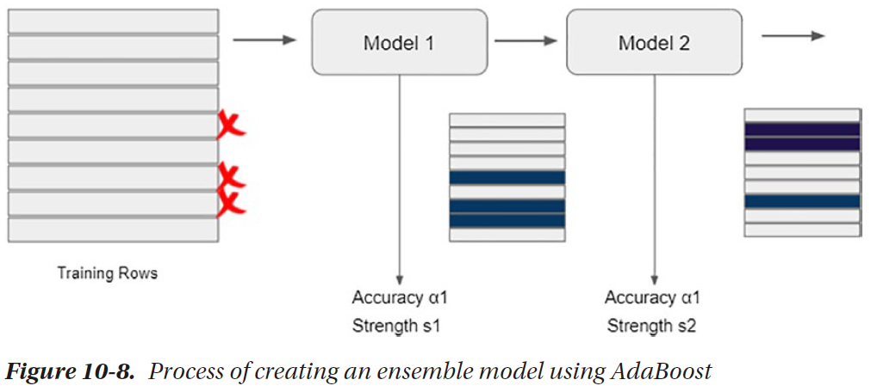

Slide 27
Each model’s accuracy is directly used as the notion of strength of the classifier which will be used while predicting.
While predicting classification results on unseen data, instead of voting the results of all the models like in Bagging methods, we calculate the weighted average of the individual models.

Slide 28
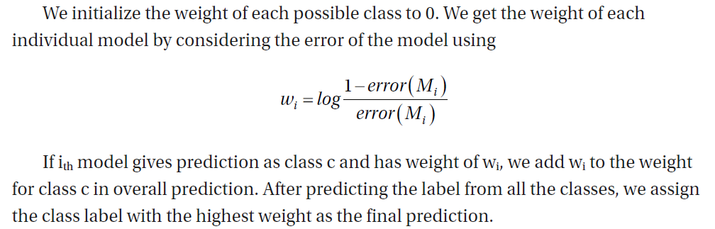

Slide 29
Boosting in Python
In Scikit-learn, sklearn.ensemble.AdaBoostClassifier accepts a base estimator, which defaults to a one-level decision tree (stump).
However, we can initialize a decision tree with different hyperparameters, which is then passed to the AdaBoostClassifier.
We can configure the number of weak learners using n_estimators and a learning rate using learning_rate, which configures the weight applied to each classifier during each iteration.
A higher learning rate increases the contribution of each individual classifier. Its default value is 1.

Slide 30
  import pandas as pd
  from sklearn.datasets import load_iris
  iris = load_iris()
  df = pd.DataFrame(iris.data, columns=iris.feature_names)
  from sklearn.model_selection import train_test_split
  X_train, X_test, y_train, y_test = train_test_split(df, iris.target,test_size=0.3)

Slide 31
  from sklearn.ensemble import AdaBoostClassifier
  from sklearn.tree import DecisionTreeClassifier
  base = DecisionTreeClassifier(criterion='gini', max_depth=1)
  model_ada = AdaBoostClassifier(base_estimator = base, n_estimators=10)
  model_ada.fit(X_train, y_train)

Slide 32
  from IPython.display import Image
  from sklearn.tree import export_graphviz
  import pydotplus
  for i, estimator in enumerate(model_ada.estimators_):
  dot_data = export_graphviz(estimator)
  graph = pydotplus.graph_from_dot_data(dot_data)
  graph.write_png('tree'+str(i)+'.png')
  display(Image(graph.create_png()))

Slide 33
The idea behind AdaBoost is to use very simple weak learners and reduce the error rate to achieve a much accurate model.

Slide 34
Let’s run an experiment on synthetic dataset and visualize the impact
of base_model on the overall accuracy.
We will construct a synthetic dataset using the klearn.dataset.make_classification method. Here’s a simple example.

Slide 35
  import matplotlib.pyplot as plt
  from sklearn.datasets import make_classification
  plt.figure(figsize=(8, 8))
  X, y = make_classification(n_samples = 1000, n_features=2, n_redundant=0,
  n_informative=2, n_clusters_per_class=1, n_classes=3)
  plt.scatter(X[:, 0], X[:, 1], marker='o', c=y, s=25, edgecolor='k’)
Here, we instruct Scikit-learn to construct a dataset containing 1000 samples with two features each and spread the data into three clusters, each denoting a class.

Slide 36
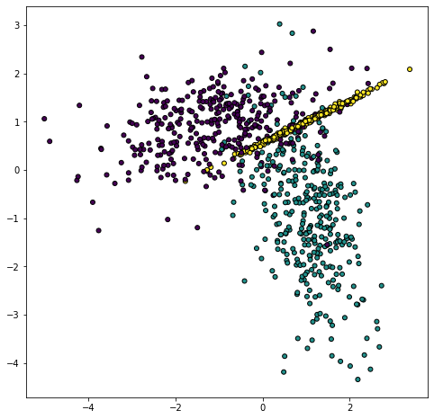

Slide 37
We will use this method to generate a more complex dataset and train an AdaBoost model out of these.
  from sklearn.model_selection import train_test_split
  X, y = make_classification(n_samples = 3000, n_features=10, n_redundant=0,
  n_informative=10, n_clusters_per_class=1, n_classes=3)
  X_train, X_test, y_train, y_test = train_test_split(X, y, test_size=0.3)
In these lines, we first create a random classification dataset with 3000 samples, each data point in ten columns spread over three classes present in their own clusters. We split the dataset into training and test set so that the reported accuracy measures come independently from the test data.

Slide 38
Let’s import the requirements. In this example, we will explicitly create objects of DecisionTreeClassifier to set the depth at different levels and analyze its impact on the overall accuracy.
A list called accuracy_A list called accuracy_history will store the accuracy of multiple models for visualization and comparison.
  from sklearn.ensemble import AdaBoostClassifier
  from sklearn.tree import DecisionTreeClassifier
  from sklearn.metrics import accuracy_score
  accuracy_history = []

Slide 39
Now we want to create multiple AdaBoost classifiers, each containing the same number of estimators, that is, 50. However, in each iteration, the depth of the constituent decision tree will be different.
  for i in range(1, 20):
  tree = DecisionTreeClassifier(max_depth = i)
  model_ada = AdaBoostClassifier(base_estimator=tree, n_estimators=50)
  model_ada.fit(X_train, y_train)
  y_pred = model_ada.predict(X_test)
  accuracy_history.append(accuracy_score(y_test, y_pred))

Slide 40
Will the classifier with better and more complex trees have significant improvement over the classifier with simpler trees?
To answer that, we will find the predictions on test dataset in each iteration and store the accuracy history in the list. Let’s visualize the accuracy history.
  plt.figure(figsize=(8, 4))
  plt.plot(accuracy_history, marker='o', linestyle='solid', linewidth=2,
  markersize=5)
  plt.grid(True)
  plt.xticks(range(1,20))
  plt.ylim((0.5,1))

Slide 41
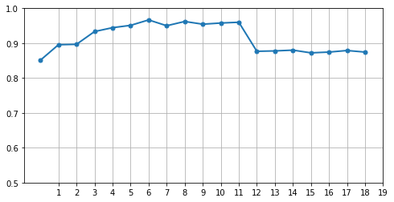

Slide 42
Stacking Ensemble
Stacking, or stacked generalization, is another ensemble learning technique that combines the predictions from multiple machine learning models by assigning the weights on individual constituent classifiers.
This is significantly different from Bagging – which is the approach of creating the same type of model (e.g., decision trees) on different samples of the training dataset.
Here, we may choose different kinds of estimators with different hyperparameters. In simple words, a stacking ensemble builds another learning layer (meta-model) that learns how to combine the predictions of constituent models.

Slide 43
Implementations of stacking ensembles differ based on the type of machine learning being solved.
If we have multiple regression models trained on the same dataset, the meta-model will take the outputs of the individual regression models and try to learn the weight of each model to produce the final numeric output.

Slide 44
Stacking in Python
Scikit-learn provides an easy to use implementation for stacking estimators using sklearn.ensemble.StackingClassifier.
It accepts a list of base models (estimators) that will be stacked together. There’s a final estimator (default logistic regression) that tries to learn to predict the final value based on the output of constituent estimators.

Slide 45
Test Data
  from sklearn.datasets import make_classification
  from sklearn.model_selection import train_test_split
  X, y = make_classification(n_samples = 3000, n_features=10, n_redundant=0,n_informative=10, n_clusters_per_class=1, n_classes=3)
  X_train, X_test, y_train, y_test = train_test_split(X, y, test_size=0.3)

Slide 46
Let’s import classifier models for logistic regression, KNN, decision trees, support vector, and naïve Bayes.
  from sklearn.linear_model import LogisticRegression
  from sklearn.neighbors import KNeighborsClassifier
  from sklearn.tree import DecisionTreeClassifier
  from sklearn.svm import SVC
  from sklearn.naive_bayes import GaussianNB

Slide 47
To keep this example simple, let’s create a list of tuples – with each tuple containing the name and the estimator object for each classifier.
We will consider the default values of all hyperparameters.
  models = [('Logistic Regression',LogisticRegression()),('Nearest Neighbors',KNeighborsClassifier()),('Decision Tree',DecisionTreeClassifier()),('Support Vector Classifier',SVC()),('Naive Bayes',GaussianNB())]

Slide 48
Let’s train and evaluate them in a loop and plot the accuracy of the five models. The output of this block is shown in Figure 10-12.
  from sklearn.metrics import accuracy_score
  accuracy_list = []
  for model in models:
  model[1].fit(X_train, y_train)
  y_pred = model[1].predict(X_test)
  accuracy_list.append(accuracy_score(y_test, y_pred))
  import matplotlib.pyplot as plt
  plt.figure(figsize=(8, 4))
  model_names = [x[0] for x in models]
  y_pos = range(len(models))
  plt.bar(y_pos, accuracy_list, align='center', alpha=0.5)
  plt.xticks(y_pos, [x[0] for x in models], rotation=45)
  plt.ylabel('Accuracy')
  plt.title('Comparision of Accuracies of Models')
  plt.show()

Slide 49
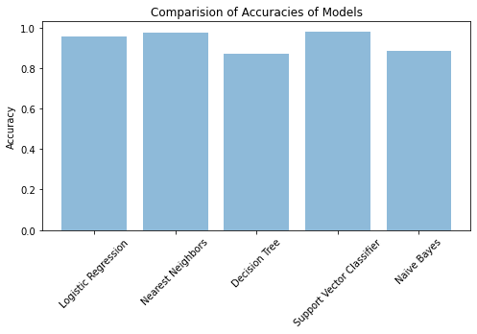

Slide 50
Instead of being able to use one of the well-performing models, we can create a stacking classifier to act as an ensemble of all the models.
We will specify the five models we initialized earlier and a logistic regression as the final estimator, which will use the results of five estimators as input and learn the weights that must be used to assign the final class.
  from sklearn.ensemble import StackingClassifier
  stacking_model = StackingClassifier(estimators=models,final_estimator=LogisticRegression(), cv=5)
  stacking_model.fit(X_train, y_train)

Slide 51
This will initiate training for each of the constituent estimators. To predict, we simply need to predict using stacking_model.
  y_pred = stacking_model.predict(X_test)
  accuracy_score(y_test, y_pred)

Slide 52
The accuracy score we thus obtain will usually be higher than the highest accuracy we obtained on any individual model.
We would like to print another bar chart comparing the accuracies of all the models.
  accuracy_list.append(accuracy_score(y_test, y_pred))
  model_names = [x[0] for x in models]
  model_names.append("Stacked Model")
  plt.figure(figsize=(8, 4))
  y_pos = range(len(model_names))
  plt.bar(y_pos, accuracy_list, align='center', alpha=0.5)
  plt.xticks(y_pos, model_names, rotation=45)
  plt.ylabel('Accuracy')
  plt.title('Comparision of Accuracies of Models')
  plt.show()

Slide 53
